Slide 1

Templating
Creating UI elements with Handlebars
SoftUni Team
Technical Trainers
Software University
http://softuni.bg

Slide 2
Table of Contents
Templating Concepts
Simple Templating
Templating Engines
Handlebars Overview
Examples

Slide 3
Have a Question?
sli.do #JSCORE

Slide 4
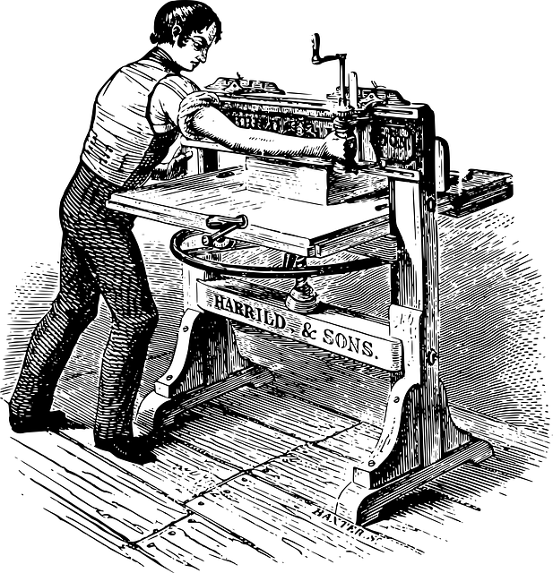
Templating Concepts
Definition and Uses

Slide 5
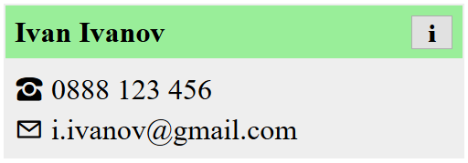

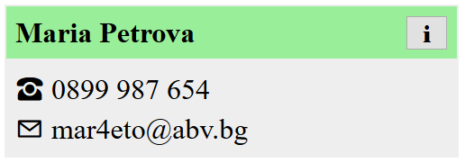
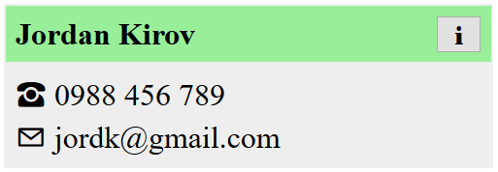
What is Templating?
Templates allow similar content to be replicated in a web page, without repeating the corresponding markup everywhere
HTML
<div>
<span>
<button>
Templating Engine
Dynamic Content
Ivan,
Maria,
Jordan, …

Slide 6
Templating Concepts
Templates are a method of separating HTML structure from the content contained within
Templating systems generally introduce some new syntax but are usually very simple to work with
Templating systems are usually Server-side or Client-side, but can be Edge-side, Outside server or Distributed
Typically token replacement is used to indicate part, which must be replaced - ({{ ... }}, <%...%> etc.)

Slide 7
Templating Concepts
The static parts of a webpage are stored as templates
The dynamic content is kept separately (e.g. in a database)
A templating engine combines the two
Benefits:
Productivity – avoid writing the same markup over and over
Save bandwidth – send the HTML once, fill in any content
Composability – a single element can be used on multiple pages

Slide 8
When should we use JS Templating
As soon as we find ourselves including HTML inside JavaScript strings we should be starting to think about what benefits JavaScript templates could give us
Separation of concerns is of utmost importance when building a maintainable codebase, so anything which can help us achieve this should be explored
It also can arguably minimize the amount of data that’s returned to the client, making sites faster and servers more responsive by lowering bandwidth and load

Slide 9



Examples
Display articles in a blog
Template
Templating Engine
Content

Slide 10
Examples
Display articles in a blog
Display a gallery of photos
Template
Templating Engine
Content

Slide 11
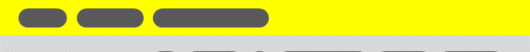
Examples
Display articles in a blog
Display a gallery of photos
Visualize user profiles
Template
Templating Engine
Content

Slide 12

Examples
Display articles in a blog
Display a gallery of photos
Visualize user profiles
Show items in a catalog
Template
Templating Engine
Content

Slide 13

Live Demo
Simple HTML Templating

Slide 14
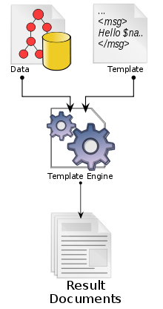
Templating Engines
Overview of Popular JS Libraries

Slide 15






Templating Engines
Pug
Vue
jQuery Templates
Underscore Templates
Mustache
Handlebars

Slide 16
Mustache Overview
Mustache is a multi-language, logic-less templating system
Key Points
9kb file size (small)
Simple
No dependencies
No logic
No precompiled templates
Programming language agnostic

Slide 17
Mustache Overview
<script id="template" type="x-tmpl-mustache">
<p>Use the <strong>{{power}}</strong>, {{name}}!</p>
</script>
var template = document.getElementById('template').innerHTML;
Mustache.parse(template);
var rendered = Mustache
.render(template, {name: "Luke", power: "force"});
document.getElementById('target').innerHTML = rendered;

Slide 18
jQuery Overview
jQuery Template is not as popular as mustache.js
The templates are just plain HTML with no new syntax
Instead of token replacement techniques it uses data attributes to indicate where data should be inserted in the HTML fragment
Key Points
7kb file size (small)
Requires jQuery (+82kb)
Simple, but different to how Mustache and Handlebars.js work
No precompiled templates

Slide 19
jQuery Overview
<script id="template" type="text/html">
<p>
Use the <strong data-content="power"></strong>,
<span data-content="name"></span>!
</p>
</script>
$('#target').loadTemplate($('#template'), {
name: "Luke",
power: "force"
}
);

Slide 20
Templating with Handlebars
Syntax and Examples

Slide 21
Overview
Based on the Mustache specification
Adds helper functions and nested context paths
Uses double curly brace notation {{ }}
<div class="entry">
<h1>{{ title }}</h1>
<div class="body">
{{ body }}
</div>
</div>
<div class="entry">
<h1>My New Post</h1>
<div class="body">
This is my first post!
</div>
</div>

Slide 22
Installation
Download Handlebars using WebStorm's terminal
Or download from handlebarsjs.com
Browser builds will be located in
Use handlebars from an online CDN:
npm install --save handlebars
node_modules/handlebars/dist/
https://cdnjs.cloudflare.com/ajax/libs/handlebars.js/4.0.10/
handlebars.min.js

Slide 23
Expressions
You can place your templates in a script element
Use type text/x-handlebars-template
Give the element an ID for easier use
Anything inside double curly braces {{ }} will be evaluated
Set the context by executing the template with an object
Named identifiers will be looked up in the object's properties
Handlebars supports conditional statements and other helpers

Slide 24
Compilation and Execution
Once loaded, a template must be compiled
Compiled templates are functions, that can be executed with whatever variables we need
let source = $("#contact-template").html();
let template = Handlebars.compile(source);
let context = {
name: 'Ivan Ivanov',
phone: '0888 123 456',
email: 'i.ivanov@gmail.com'
};
let html = template(context);

Slide 25
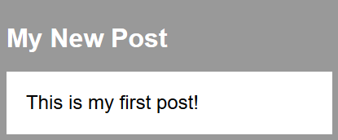
Example
<script id="entry-template" type="text/x-handlebars-template">
<div class="entry">
<h1>{{title}}</h1>
<div class="body">{{body}}</div>
</div>
</script>
let source = $("#entry-template").html();
let template = Handlebars.compile(source);
let context = {
title: "My New Post",
body: "This is my first post!"
};
let html = template(context);
Compile the template
from a string
Populate with data

Slide 26
Hello Handlebars
<!DOCTYPE html>
<head>
<meta charset="UTF-8">
<title>Hello Handlebars</title>
<!-- Include Handlebars distribution -->
</head>
<body>
<div id="app"></div>
<script>
let template = Handlebars.compile('<h1>Hello {{name}}</h1>');
let container = document.getElementById('app');
container.innerHTML = template({ name: 'Handlebars' });
</script>
</body>
</html>

Slide 27
Simple Identifiers
<script id="contact-template"
type="text/x-handlebars-template">
<article>
<div class="title">
{{name}}
<button>&#8505;</button>
</div>
<div class="info">
<span>&phone; {{phone}}</span>
<span>&#9993; {{email}}</span>
</div>
</article>
</script>

Slide 28
For-Loops
A template can be repeated for every entry in an array
let context = {
contacts: [
{ name: 'Ivan Ivanov', email: 'i.ivanov@gmail.com'},
{ name: 'Maria Petrova', email: 'mar4eto@abv.bg'},
{ name: 'Jordan Kirov', email: 'jordk@gmail.com'}
]};
<ul id="contacts">
{{#each contacts}}
<li>{{name}}: {{email}}</li>
{{/each}}
</ul>
The expression inside
the loop uses each
entry as context

Slide 29
Conditional Statements
Variable to check
for truthiness
{{#if sunny}}
The sky is clear
{{else}}
The sky is overcast
{{/if}}
<ul id="contacts">
{{#each contacts}}
<li>{{name}}: {{email}}</li>
{{else}}
<i>(empty)<i>
{{/each}}
</ul>
Will be shown if
the array is empty

Slide 30
Partials
Partials are templates that can be inserted into other templates
let source = $("#contact-template").html();
Handlebars.registerPartial('contact', source);
Partial name
Template as string
<div id="contacts">
{{#each contacts}}
{{> contact}}
{{else}}
<i>(empty)<i>
{{/each}}
</div>
Partials are
globally accessible

Slide 31
HTML Escaping
By default, any strings that are evaluated will be HTML-escaped
To prevent this, use the "triple-stash"
title: "All about <p> Tags"
body: "<p>This is a post about &lt;p&gt; tags</p>"
<div class="entry">
<h1>All About &lt;p&gt; Tags</h1>
<div class="body">
<p>
This is a post about&lt;p&gt; tags
</p>
</div>
</div>
<div class="entry">
<h1>{{title}}</h1>
<div class="body">
{{{body}}}
</div>
</div>

Slide 32
Live Demo
Templating with Handlebars

Slide 33

Live Exercises in Class (Lab)
Practice: Templating

Slide 34

Summary
…
…
…
Templates speed up and simplify the
development process
Handlebars offers effective templates and simple helper functions
<div class="entry">
<h1>{{ title }}</h1>
<div class="body">
{{ body }}
</div>
</div>
<div class="entry">
<h1>My New Post</h1>
<div class="body">
This is my first post!
</div>
</div>

Slide 35
https://softuni.bg/trainings/2081/js-advanced-october-2018

Slide 36













SoftUni Diamond Partners

Slide 37





SoftUni Organizational Partners

Slide 38




Trainings @ Software University (SoftUni)
Software University – High-Quality Education and Employment Opportunities
softuni.bg
Software University Foundation
http://softuni.foundation/
Software University @ Facebook
facebook.com/SoftwareUniversity
Software University Forums
forum.softuni.bg

Slide 39

License
This course (slides, examples, demos, videos, homework, etc.) is licensed under the "Creative Commons Attribution-NonCommercial-ShareAlike 4.0 International" license

